Slide 1
HEADACHE SYNDROMES

Slide 2
Introduction
Headaches are often classified as primary or secondary, depending on the underlying cause
There are many causes of secondary headache due to structural, infective, inflammatory or vascular conditions, but these are dealt with elsewhere.
The primary headache syndromes are discussed in the following section.

Slide 3
1. Primary headache syndromes
Tension-type headache (persistent daily headache)
Migraine
Cluster headache
Trigeminal neuralgia
Atypical facial pain
Benign paroxysmal headaches

Slide 4
2. Secondary causes of headache
Intracerebral bleeding (subdural haematoma, subarachnoid or intracerebral haemorrhage)
Raised intracranial pressure (brain tumour, idiopathic intracranial hypertension)
Infection (meningitis, encephalitis, brain abscess)
Inflammatory disease (temporal arteritis, other vasculitis, arthritis)
Post-herpetic neuralgia
Referred pain from other structures (orbit, temporo-mandibular joint, neck)

Slide 5
1. Tension-type headache
This is the most common type of headache and is experienced at some time by the majority of the population in some form.
Pathophysiology
The cause of tension headaches is incompletely understood.
Emotional strain or anxiety is a common precipitant to tension-type headache and there is sometimes an associated depressive illness.
Anxiety about the headache itself may lead to continuation of symptoms, and patients often become convinced of a serious underlying condition.
Muscular spasms in the head and neck have been suggested to be a cause but there is little direct evidence for this.

Slide 6
Clinical features
The pain of tension headache is usually constant and generalised but often radiates forward from the occipital region.
It is described as 'dull', 'tight' or like a 'pressure', and there may be a sensation of a band round the head or pressure at the vertex.
In contrast to migraine, the pain may continue for weeks or months without interruption, although the severity may vary, and there is no associated vomiting or photophobia.
The patient can usually continue normal activities, and the pain may be less noticeable when the patient is occupied.
The pain is characteristically less severe in the early part of the day and becomes more troublesome as the day goes on.
Local tenderness may be present over the skull vault or in the occiput but this should be distinguished from the acute pain precipitated by skin contact in trigeminal neuralgia and the exquisite tenderness of temporal arteritis.
Typically, the headache does not respond well to treatment with analgesics.

Slide 7
Management
Careful assessment followed by discussion of likely precipitants and explanation of the fact that the symptoms are not due to any sinister underlying pathology is more likely to be beneficial than analgesics.
Excessive use of analgesics, particularly of codeine, may actually worsen the headache (analgesic headache).
Physiotherapy (with muscle relaxation and stress management) is usually beneficial.
Low-dose amitriptyline (10 mg nocte increased gradually to 30-50 mg) sometimes helps.
There is evidence that patients benefit from a perception that their problem has been taken seriously and rigorously assessed, but over-investigation can worsen a patient's anxiety.

Slide 8
2. Migraine
Is a common condition.
Affects 20% of females and 6% of males at some point in life.
Migraine usually presents before the age of 40 and it has been estimated that 90% of migraine sufferers have their first attack by this time.
Although some patients refer to any episodic paroxysmal headache as migraine, there is a characteristic presentation.

Slide 9
Pathophysiology
Not completely understood
Many theories e.g.
  Aura is due to dysfunction of ionic channels especially calcium channels
  Genetic predisposition, because family history is common
  Great female predisposition hints to hormonal influence
  Some patients have identifiable dietary precipitants e.g. chocolate, red wine.
  Psychological stress – e.g. over the weekends, start of holidays
The headache is associated with vasodilatation of extra cranial vessels, but may be due to disturbed neuronal activity in the hypothalamus.

Slide 10
Clinical features
Migraine presents with a symptom triad of;
  paroxysmal headache,
  nausea and/or vomiting, and
  an 'aura' of focal neurological events (usually visual).
Patients with all three of these features are said to have migraine with aura ('classical' migraine).
Those with paroxysmal headache (with or without vomiting) but no 'aura' are said to have migraine without aura ('common' migraine).

Slide 11
A classical migraine attack
Starts malaise and irritability followed by the aura of a focal neurological event, and then a severe, throbbing, hemicranial headache with photophobia and vomiting.
During the headache phase, patients prefer to be in a quiet, darkened room and to sleep.
The headache may persist for several days.

Slide 12
The aura most often takes the form of fortification spectra, which are shimmering, silvery zigzag lines which march across the visual fields over a period of about 20 minutes, sometimes leaving a trail of temporary visual field loss.
In some patients there is a sensory aura which is a spreading front of tingling followed by numbness which moves, over 20-30 minutes, from one part of the body to another.
If the dominant hemisphere is involved, the patient may also experience transient aphasia.
Limb weakness can occur in migraine and is termed hemiplegic migraine. However, this is unusual and should be diagnosed with extreme caution.
In some patients the focal events may occur by themselves ('migraine equivalent'), but in this case other structural disorders of the brain, or even focal epilepsy, need to be considered in the differential diagnosis.
In a smaller number of patients, the symptoms of the aura do not resolve, leaving more permanent neurological disturbance ('complicated migraine').

Slide 13
Management
Identification and avoidance of precipitants or exacerbating factors (such as the contraceptive pill) may prevent attacks.
Treatment of an acute attack consists of simple analgesia with aspirin or paracetamol, often combined with an antiemetic such as metoclopramide or domperidone.
Severe attacks can be treated with one of the 'triptans' (e.g. sumatriptan), 5-HT agonists that are potent vasoconstrictors of the extracranial arteries. These can be administered orally, sublingually, by subcutaneous injection or by nasal spray.
If attacks are frequent, they can often be prevented with propranolol (80-160 mg daily, in a sustained-release preparation), a tricyclic such as amitriptyline (10-50 mg at night), sodium valproate (300-600 mg/day) or topiramate (50-100 mg/day).
Women should be warned that the small risk of ischaemic stroke attributable to taking oral contraception is increased if they have migraine with aura (see above), especially if they also smoke.

Slide 14
Note
  Ergotamine preparations should be avoided since they easily lead to dependence. This is less likely to happen with the triptans, but it can occur.
  Long-term use of codeine-containing analgesic preparations should be avoided.

Slide 15
3. Cluster headache
cluster headaches (also known as migrainous neuralgia) are 10-50 times less common than migraine.
There is a 5:1 predominance of males and onset is usually in the third decade.
Pathophysiology
The cause is unclear.
There is little evidence for a genetic predisposition, there are no provoking dietary factors and there is a male predominance. Functional imaging studies have suggested abnormal neuronal activity in the hypothalamus. Patients are usually heavy smokers with a higher than average alcohol consumption.

Slide 16
Clinical features
The characteristic presentation is with periodic, severe, unilateral periorbital pain accompanied by unilateral lacrimation, nasal congestion and conjunctival injection, often with the other features of Horner's syndrome.
The pain, whilst being very severe, is characteristically brief (30-90 minutes).
Typically, the patient develops these symptoms at a particular time of day (often in the early hours of the morning).
The syndrome may occur repeatedly for a number of weeks, followed by a respite for a number of months before another cluster occurs.

Slide 17
Management
Acute attacks can usually be halted by subcutaneous injections of sumatriptan or by inhalation of 100% oxygen, but other migraine therapies are ineffective, probably because of the brevity of the individual attacks.
Preventative therapy with the agents used for migraine is often ineffective but attacks can be prevented in some patients by verapamil (80-120 mg 8-hourly), methysergide (4-10 mg daily, for a maximum of 3 months only) or short courses of oral corticosteroids.
Patients with severe and debilitating clusters can be helped with lithium therapy, although the usual precautions concerning the use of this drug should be observed

Slide 18
Other headache syndromes
Benign paroxysmal headaches
There are a number of rare headache syndromes which produce pains about the eye similar to cluster headaches.
These include chronic and paroxysmal hemicrania, and SUNCT (short-lasting unilateral neuralgiform headaches with conjunctival injection and tearing).
The recognition of these syndromes is useful since they often respond to specific treatments such as indometacin.

Slide 19
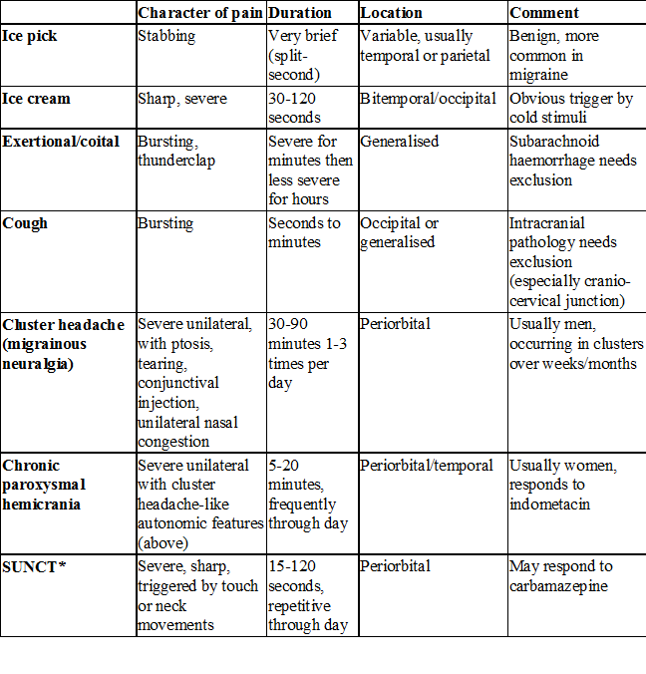

Slide 20
Trigeminal neuralgia
This is characterised by lancinating pain in the second and third divisions of the trigeminal nerve territory, usually in patients over the age of 50 years.

Slide 21
Pathophysiology
Trigeminal neuralgia is thought to be caused by an aberrant loop of the cerebellar arteries compressing the trigeminal nerve as it enters the brain stem.
Other compressive lesions, usually benign, are occasionally found.
When trigeminal neuralgia occurs in multiple sclerosis, there is a plaque of demyelination in the trigeminal root entry zone.

Slide 22
Clinical features
The pain is severe and very brief but repetitive, causing the patient to flinch as if with a motor tic (hence the French term for the condition, 'tic douloureux').
It may be precipitated by touching trigger zones within the trigeminal territory, by cold wind blowing on the face, or by eating.
Physical signs are usually absent.
Similar symptoms may occur in multiple sclerosis or, rarely, with other brain-stem lesions, in which case there may be sensory changes in the trigeminal nerve territory (and possibly other brain-stem symptoms and signs).
There is a tendency for the condition to remit and relapse over many years.

Slide 23
Management
The pain usually responds to carbamazepine in doses of up to 1200 mg daily.
It is wise to start with a low dose and increase gradually, according to effect.
In patients who cannot tolerate carbamazepine, gabapentin or pregabalin may be effective.
Various surgical treatments are available, the simplest of which is injection of alcohol or phenol into a peripheral branch of the nerve.
Probably more effective is making a radiofrequency lesion in the nerve near the Gasserian ganglion.
Care has to be taken not to cause excessive damage to sensation in the face to prevent the complication of neurogenic pain ('anaesthesia dolorosa') which is worse than the neuralgia.
Alternatively, the vascular compression of the trigeminal nerve can be relieved through a posterior craniotomy, often with substantial success. This latter approach is usually favoured in younger patients in whom the other injection treatments may have to be repeated and become less effective.

Slide 24

The End

